Slide 1

Instructions Please read the instruction given in this section
This PowerPoint document is a guideline for the preparation of all GBIF presentations.
Guidance for how to construct slides and tutorials on particular techniques can be found in the speaker notes section at the bottom of the screen for each layout.
For more detailed guidance, we have provided step by step tutorials in form of screenshots and highlighted important areas.

Slide 2
Guides The grid is there to help with the placement of content and images
Display viewing guides when working on slides. Click “view” on the menu bar and select “Guides”.
Going beyond the highlighted box isn’t recommended.
Your text & image should always fit in between the green box.
If there is only text in your slide it should be placed inside the blue box

Slide 3

Slide Master Use set layouts in the slide master
To make the most of this pre-set toolkit, please use only the layout options given and created in the slide master section:
Create a new page/slide
Right click on the slide
Click on Layout
Choose your desired layout from the list.
NOTE: DO NOT DELETE ANYTHING FROM THE MASTER SLIDES DIRECTLY
DO NOT DELETE ANY LAYOUT OPTIONS FROM THE SLIDE MASTER DIRECTLY

Slide 4
Colours The purpose is to give GBIF an unmistakable identity
There are 10 default colors available in the top row of the default PPT color palette: Theme colors.
Try not use any of the tints
Theme colors are the only colors permitted
Primary colours
Secondary colours

Slide 5
Headline font: Bitter semibold, 48pt
For consistency always check the font size throughout the document.
The default font size for the body text is set for 36pt however, you can change this to smaller size if required.
The smallest font size in body text should not be smaller than 20pt or bigger than 44pt.
Larger font sizes can be used for making big points.
Use the bold option to emphasise your point.
The body text colour is dark grey. Please do not use black colour in this document.

Slide 6
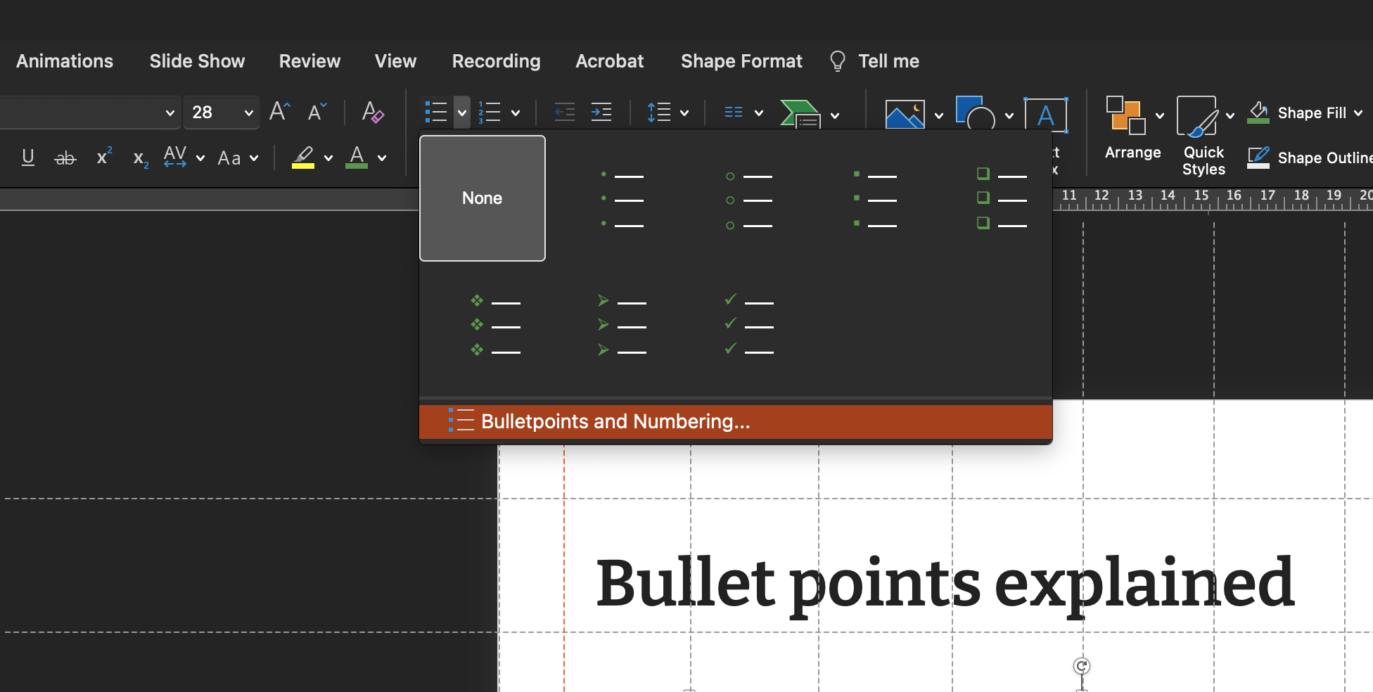
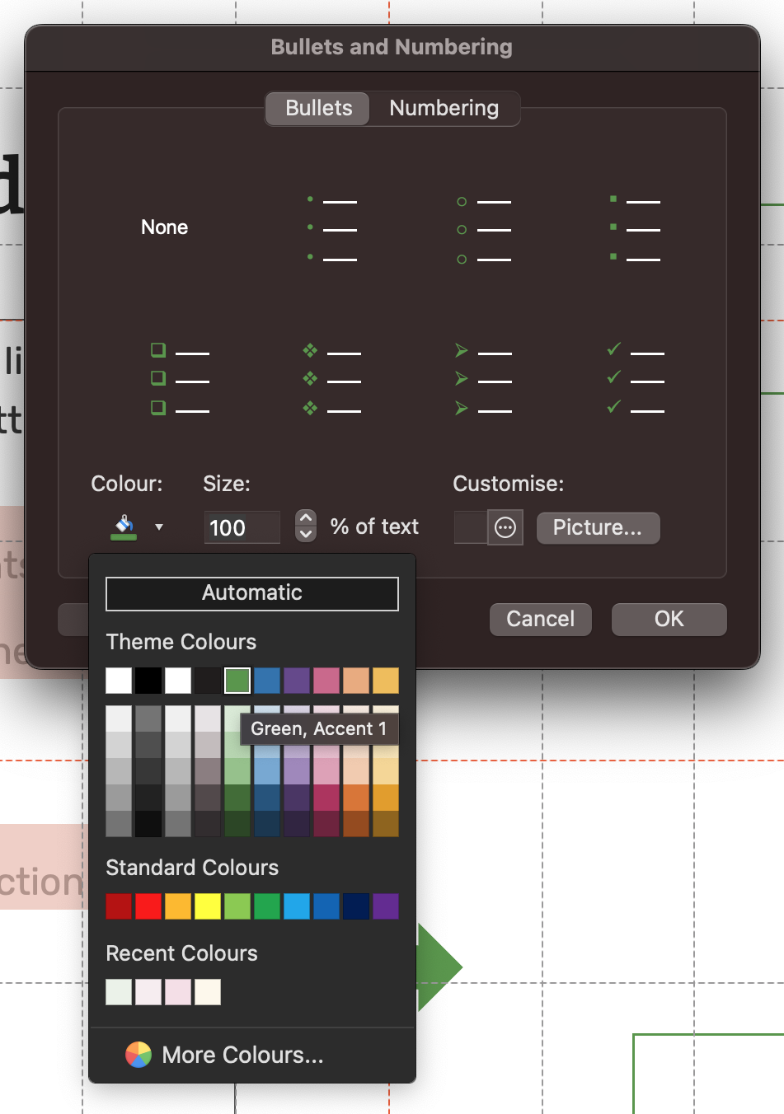
Bullet points explained
The bullet point colour and numbered lists default to GBIF green. To access bullet formatting options:
Select the text box with bullet points
Click on the drop-down menu on the home ribbon
Click on Bullets & Numbering
Select GBIF Green in the colour section
Click OK
2
1
3
4

Slide 7
Lines & shapes Use these default shapes and lines throughout the document
Lines:
Use light green or grey thin lines to separate elements on page.
Use these costume lines to create a visual impact on important sentences or/and on coloured text boxes. You can use different coloured lines based on your needs. These are some examples:
Shapes:
Try to use shapes without outlines, drop/inner shadows or gradient colours.
Correct 😊
Incorrect 😵‍💫

Slide 8
Frequently used slides explained
To re-use this slides please copy and paste the whole slide into your decks.
We recommend that you copy and paste your desired slide into an existing deck or a new deck and then apply your changes. This way, your toolkit will stay consistent, and the changes won’t effect the overall/original designed version.

